Slide 1


Air Ticket Resevation System
The project
Is submitted
By:-
PRANJAL CHOWDHURY
PARTHO PROTIM SARKAR
Bidisha Biswas
Arup Mathura

Slide 2
Content
Objective
.Working Flow
Modules
Software requirements
Need of Airline System
Scope of Airline System
Conclusion and Future Scope Contents

Slide 3
Objective
Airline Reservation System contains the details about flight schedules and its fare tariffs, passenger reservations and ticket records. An airline’s inventory contains all flights with their available seats.
(ARS) is a computerized system used to store and retrieve information and conduct transactions related to air travel Objective

Slide 4
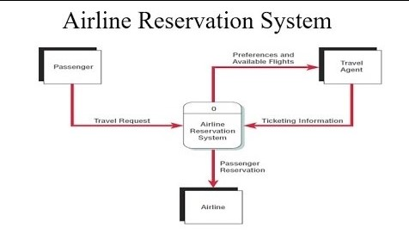
Working Flow

Slide 5
Modules
Registration module
Administrative module
Passenger Module Modules

Slide 6
Registration Module
Firstly we ask passenger to give his details .
After registering the passenger can logon to his/her own account and book his flight.
Once Passenger registered with us can book any number of tickets. Registration Module

Slide 7
Administrative Module
It is provided for the sake of administrators to manage the site and update the content at regular intervals, The major operations included in this module are:
Create and maintain airline schedule, fare and timings of the Flight.
View the passenger list.
View the available seats in the flights.
Cancel the tickets.
Updating the flight schedule and timings and fare Administrative Module

Slide 8
Passenger Module
It is meant for passengers, where a user logging into his/her owns account will view this panel. The major operations included in this module were:
View all airline schedules, timings, fare details and seats availability.
Book for the tickets.
View and cancelling of the ticket. ▪ Send feedback Passengers Module

Slide 9
Software Requirements
Software Requirements:-

Slide 10
Need of Airline System
A few factors that direct us to develop a new system are given below -:
Faster System
Accuracy
Reliability
Informative
Reservations and cancellations from anywhere to any place Need of Airline System

Slide 11
Scope of Airline System
Airline Reservation System make the life of passengers very easy as the
don’t need to stand in queues for getting their seats reserved and they can easily make reservations on any airline just from a single system.
The purpose of Airline reservation system project is to build an application program which airline could use to manage the reservation of airlines ticket. Scope and Purpose.

Slide 12
Conclusion
This is a online reservation system, which enable customer to check the availability tickets & book their tickets .
It makes the customer easy to get ticket online instead of queue up to buy the tickets

Slide 13
THANK YOU

